Slide 1
Project management for data analysis

Slide 2
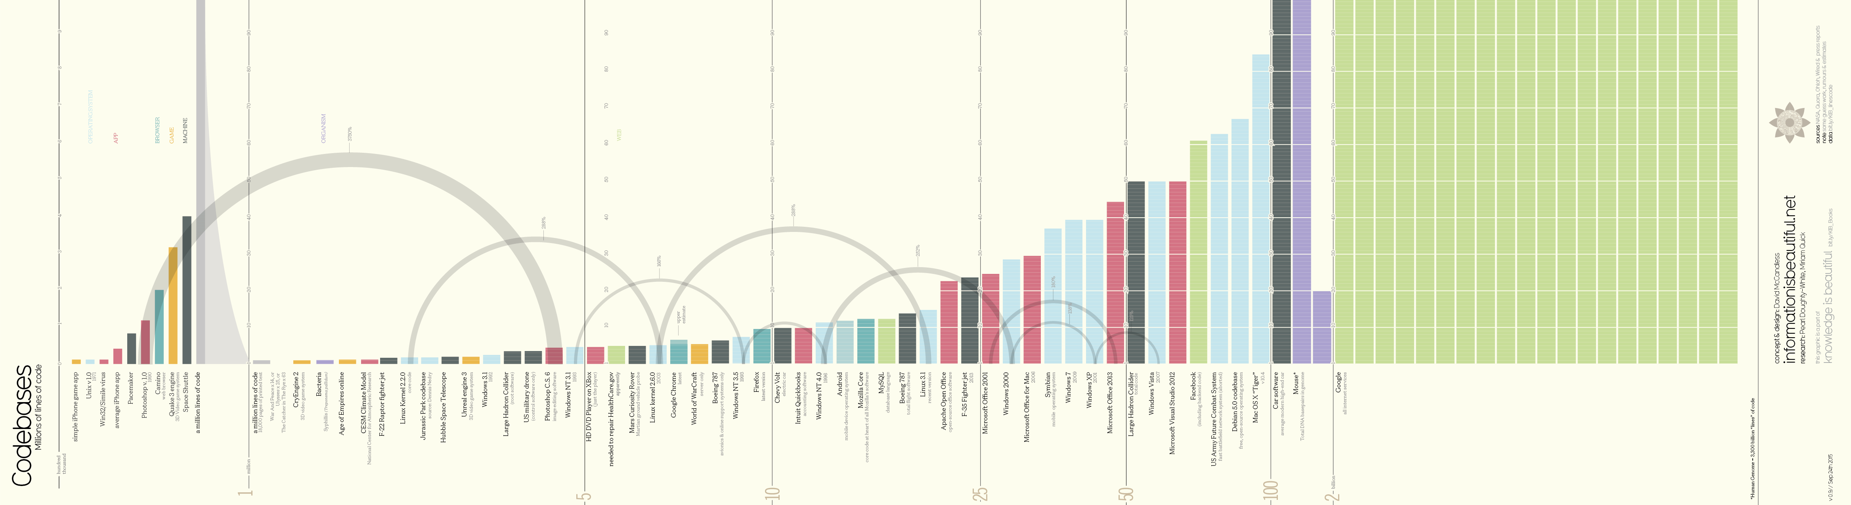
Our world is complex
http://www.informationisbeautiful.net/visualizations/million-lines-of-code/

Slide 3
Bug infestations: typical error rates
(a) Industry Average: "about 15 - 50 errors per 1000 lines of delivered code." He further says this is usually representative of code that has some level of structured programming behind it, but probably includes a mix of coding techniques.
(b) Microsoft Applications: "about 10 - 20 defects per 1000 lines of code during in-house testing, and 0.5 defect per KLOC (KLOC IS CALLED AS 1000 lines of code) in released product (Moore 1992)." He attributes this to a combination of code-reading techniques and independent testing (discussed further in another chapter of his book).
(c) "Harlan Mills pioneered 'cleanroom development', a technique that has been able to achieve rates as low as 3 defects per 1000 lines of code during in-house testing and 0.1 defect per 1000 lines of code in released product (Cobb and Mills 1990). A few projects - for example, the space-shuttle software - have achieved a level of 0 defects in 500,000 lines of code using a system of format development methods, peer reviews, and statistical testing."
http://www.mayerdan.com/ruby/2012/11/11/bugs-per-line-of-code-ratio/
McConnell, S. (2004). Code complete. Pearson Education.

Slide 4
Bug infestations: typical error rates
When is the last time you got a 100% on a difficult math assignment?
Just because your code runs and produces results, does not mean bugs do not exist.
How can we minimize error in our computer code?

Slide 5
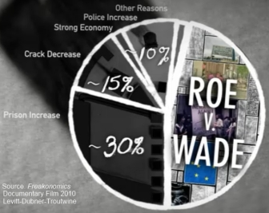
The freakanomics fiasco
http://isteve.blogspot.com/2005/11/freakonomics-fiasco-summarized.html
Response:
http://freakonomics.com/2005/05/15/abortion-and-crime-who-should-you-believe/

Slide 6
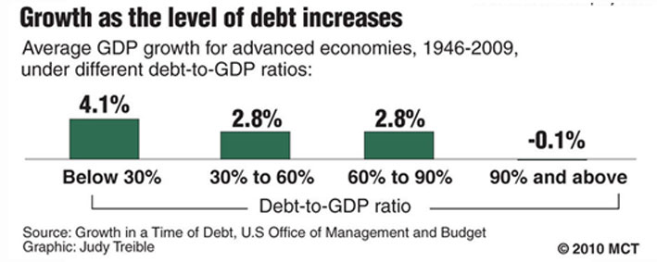
Growth in a Time of Debt: the Reinhart & Rogoff Controversy
http://www.newyorker.com/news/john-cassidy/the-reinhart-and-rogoff-controversy-a-summing-up
Holy Coding Error, Batman:
http://krugman.blogs.nytimes.com/2013/04/16/holy-coding-error-batman/?_r=0
http://www.bloomberg.com/bw/articles/2013-04-18/faq-reinhart-rogoff-and-the-excel-error-that-changed-history

Slide 7
Replication of ground-breaking scientific research
A few years ago scientists at Amgen, an American drug company, tried to replicate 53 studies that they considered landmarks in the basic science of cancer, often co-operating closely with the original researchers to ensure that their experimental technique matched the one used first time round. According to a piece they wrote last year in Nature, a leading scientific journal, they were able to reproduce the original results in just six.
http://www.economist.com/news/briefing/21588057-scientists-think-science-self-correcting-alarming-degree-it-not-trouble

Slide 8
Project management

Slide 9
Organizing your project

Slide 10

Keep your code organized by separating all of the components. Your primary scripts go in the main project folder, and all of the supporting resources go in their own folders.
Main Project Folder
Data
Workflow: check out data from the data folder, source helper functions, perform your analysis, then save all results in the results folder.
Functions
Results
R Scripts Here.R

Slide 11

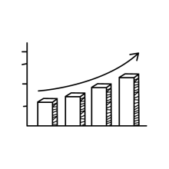


Analysis (leaves)
Data Preparation (trunk)
Data (roots)

Slide 12


Datasets
Main Branch
Results
Data
Script
Table
Data
Data
Script
Graph
Data
Script
Data
Graph
Script
Script
Table

Slide 13
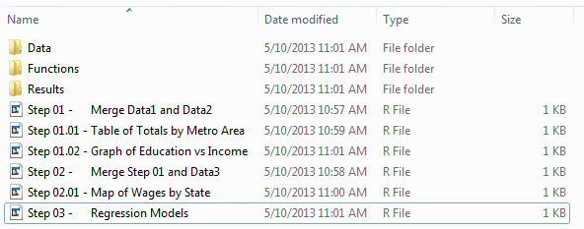

Slide 14
Recursive Scripts
source( “Step 02.R” )
source( “Step 01.R” )
Step 03
Step 02
Step 01

Slide 15
Datasets
Main Branch
Results
Data1
Step 01
Table
Data2
Merge1
Step 01.01
Graph
Data3
Step 02
Merge2
Graph
Step 02.01
Step 03
Table

Slide 16
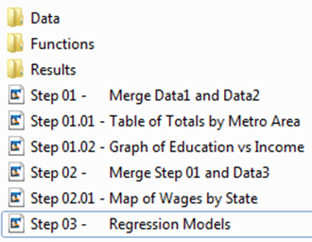
Datasets
Main Branch
Results
Data1
Step 01
Table
Data2
Merge1
Step 01.01 Step 01.02
Graph
Data3
Step 02
Merge2
Graph
Step 02.01
Step 03
Table

Slide 17
Step 01
dat1 <- read.csv( “./Data/Data1.csv” )
dat2 <- read.csv( “./Data/Data2.csv” )
# read data from your Data folder
merge1 <- merge( dat1, dat2 )
# do not need to write merge1 as a new # data set – it exists in memory only
Data1
Step 01
Data2
Merge1
R does not alter data that is held in memory, so unless you over-write your original data it will not be changed.

Slide 18
Step 02
Merge1
source( “Step 01.R” )
# loads the data from Step 01
# merge1 now in memory
dat3 <- read.csv( “./Data/Data3.csv” )
merge2 <- merge( merge1, dat3 )
Data3
Step 02
Merge2
Note that you are not altering original data and not saving copies of new data sets.

Slide 19
Step 01.01
source( “Step 01.R” )
# loads the data from Step 01
# merge1 now in memory
tab.01 <- table( x1, x2 )
write.table( tab.01,
file=“./Results/Table1.txt” )
jpg( file=“./Results/Figure1.jpg” )
plot( x1, y1, main=“Figure 1” )
dev.off()
# results go in your Results folder
# as to not clutter your main folder
Table
Merge1
Step 01.01
Graph
Answers the perennial question, which data set did I use to create that table and why doesn’t it match what’s in the paper?

Slide 20
Step 03
source( “Step 02.R” )
# the first line in Step 02
# is source( “Step 01.R” )
# so Step 01 will be executed
# recursively by Step 02
m.01 <- lm( merge2$y ~ merge2$x1 )
m.02 <- lm( merge2$y ~ merge2$x2 )
mtable.01 <- mtable( “Model 1”=m.01,
“Model 2”=m.02 )
write.mtable( mtable.01,
file=“./Results/Table 2.txt” )
Merge2
Step 03
Table
Recursive calls to the main branch data steps ensures that any changes in your files are properly propagated. This is hugely important in bug-squashing efforts.

